Slide 1

PROJECT PRESENTATION
BY Mohamed Emad

Slide 2
INTRODUCTION
This project is to analyze data for airline company which has a lot of airports and passengers who keeps travel all of the year

Slide 3
BACKGROUND
GENERAL OVERVIEW
The coppany has 98619 airport which meanس it will be hard to use the traditional methods to analyze the data for this company so I used snowflake to this mission
TOOLS
SNOWFLAKE - SNOWFLAKE WORK SHEET- POWER BI - DRAW IO

Slide 4
STEPS
STEP 01
STEP 02
EXTRACT THE DATA FROM KAGGEL
CLEAN THE DATA WHICH WAS EXTRACTED
STEP 03
STEP 04
TRANSFORM CLEANED DATA TO FACTS & DIMENSIONS
ANALYZE DATA WITH POWER BI & SQL SHEET

Slide 5
PROBLEMS
AFTER WORKING AND MAKING TABLES ON STAR SCHEMA I FOUND SNOW FLAKE WILL BE MORE EFFCIENT SO I DROPPED THE CREATED TABLES AND MADE NEW ONE .
ALL TABLES HAVE NO SURRGET KEYS .
NO DATES FOR DIMENSION DATE .

Slide 6
METHODOLOGY
METHOD 01
METHOD 02
I extracted data from kaggle which i saw that will me to give readable and good insights
Uploaded data to snowflake and made an initial table named it ALL_DATA
METHOD 03
METHOD 03
With snowflake sheets I used SQL sheet to clean data like removing nulls and duplicates , making dimensions and facts and making SQL analysis
This is the final step by using power bi to make all visualization

Slide 7
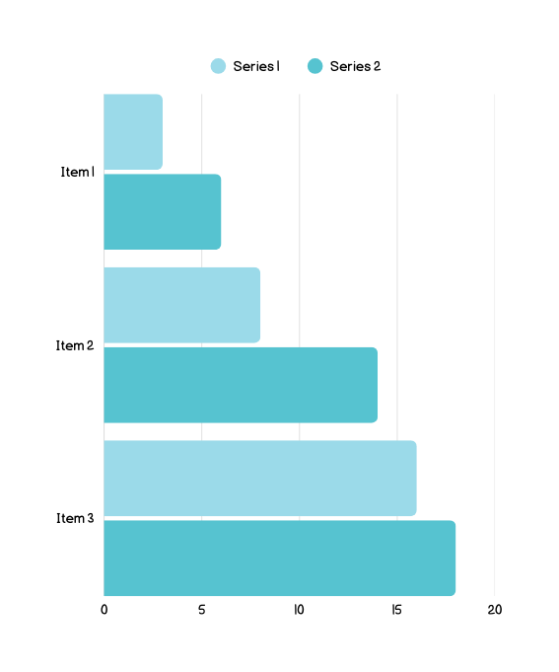
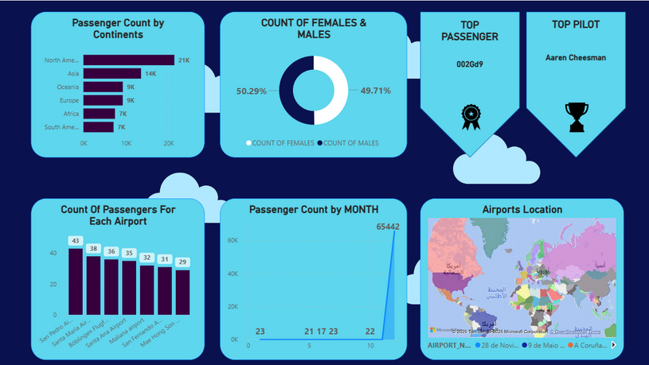
DATA ANALYSIS
To make visualization I used power bi to check the insights which will help us to improve work

Slide 8
CONCLUSION
Data ware house is here to help us to analyze data which is called place designed for analyzing structured data which will give you right insights to improve your business in different different fields

Slide 9
THANK YOU
By Mohamed Emad

